Slide 1
ANLT 207 Time Series Analysis

Slide 2
Introductions
Art Telkamp
Physicist/optical engineer
Not a data scientist, but a seasoned data analyst
Not a Python coding expert
6th time teaching this course
If questions come up…
If anything is unclear, please stop me and ask!
Chances are, others have the same question

Slide 3

Syllabus
But please use Canvas internal e-mail. I check Canvas more often.
canvas.pacific.edu

Slide 4
This course
Time Series Analysis software
GRETL
MATLAB
Python
R
SAS
STATA
And many others…
Statistical theory & mathematical treatment
Practical application & use of analysis software
This course

Slide 5
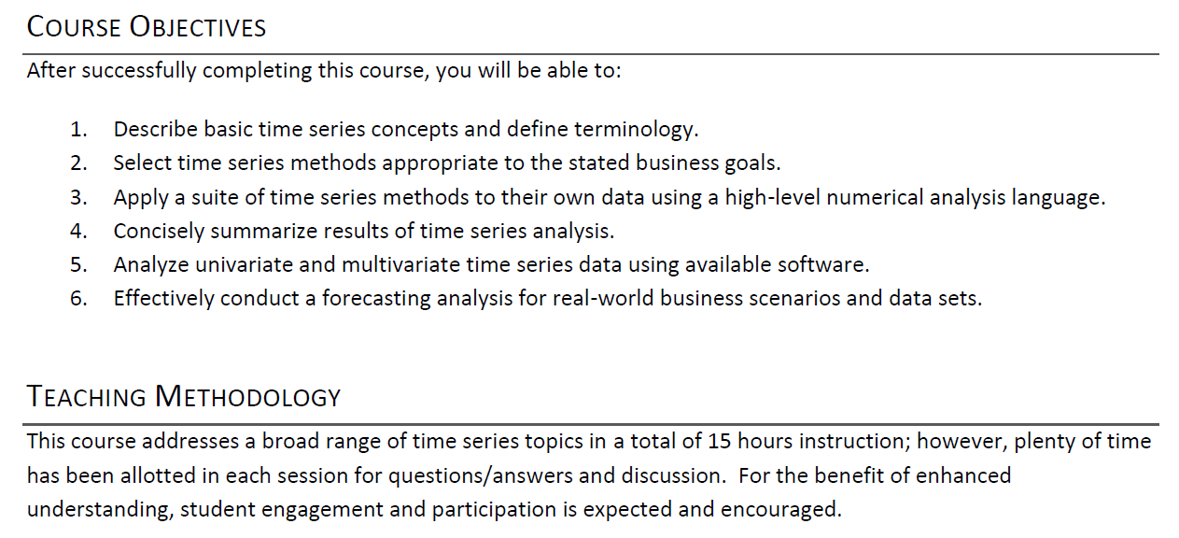
Syllabus

Slide 6
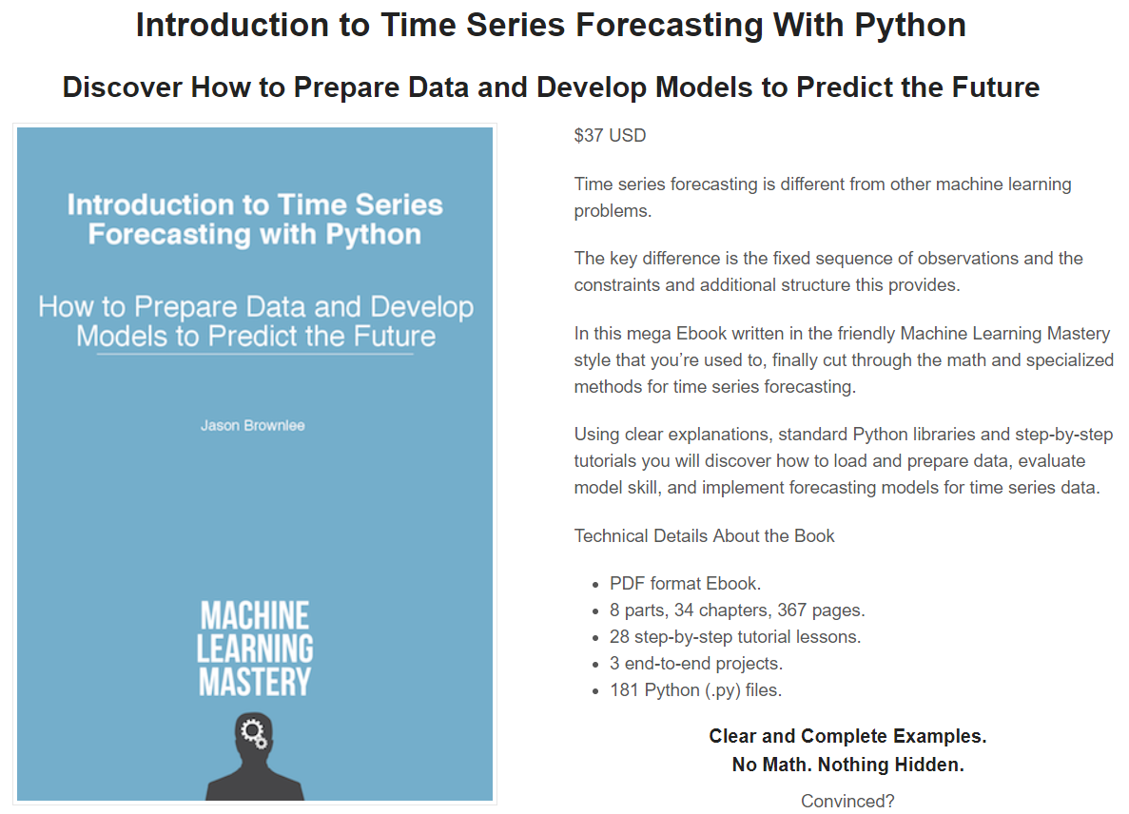
The e-book we’ll be using
https://machinelearningmastery.com/introduction-to-time-series-forecasting-with-python/

Slide 7
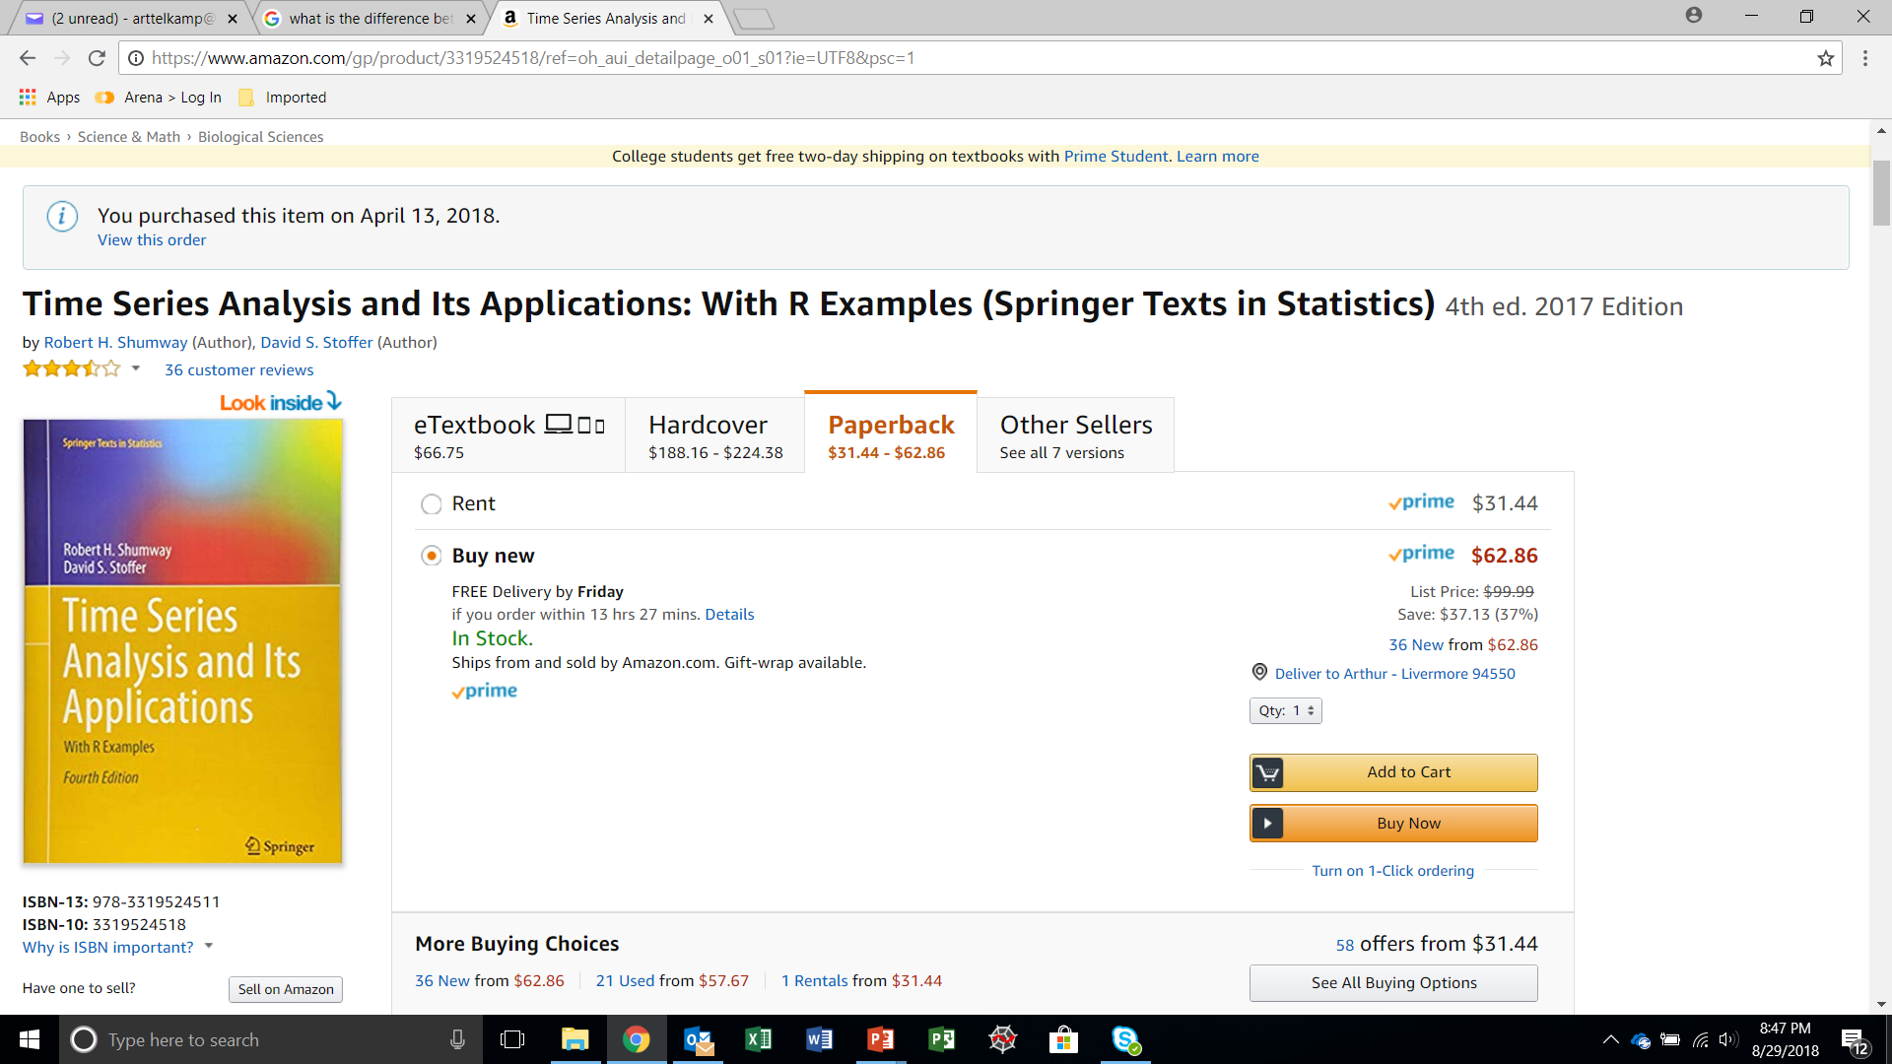
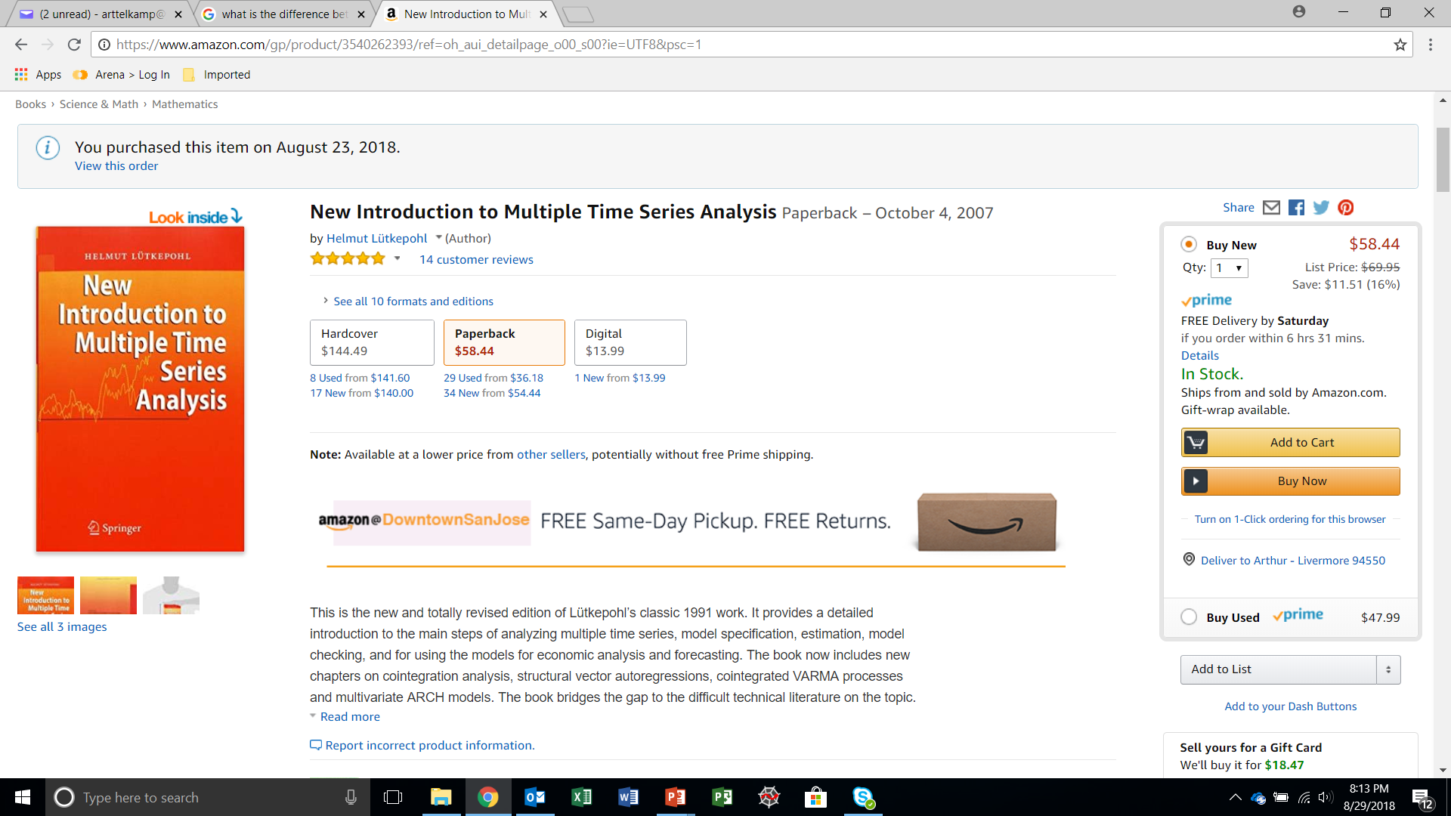
Other supplemental books (but not required)

Slide 8

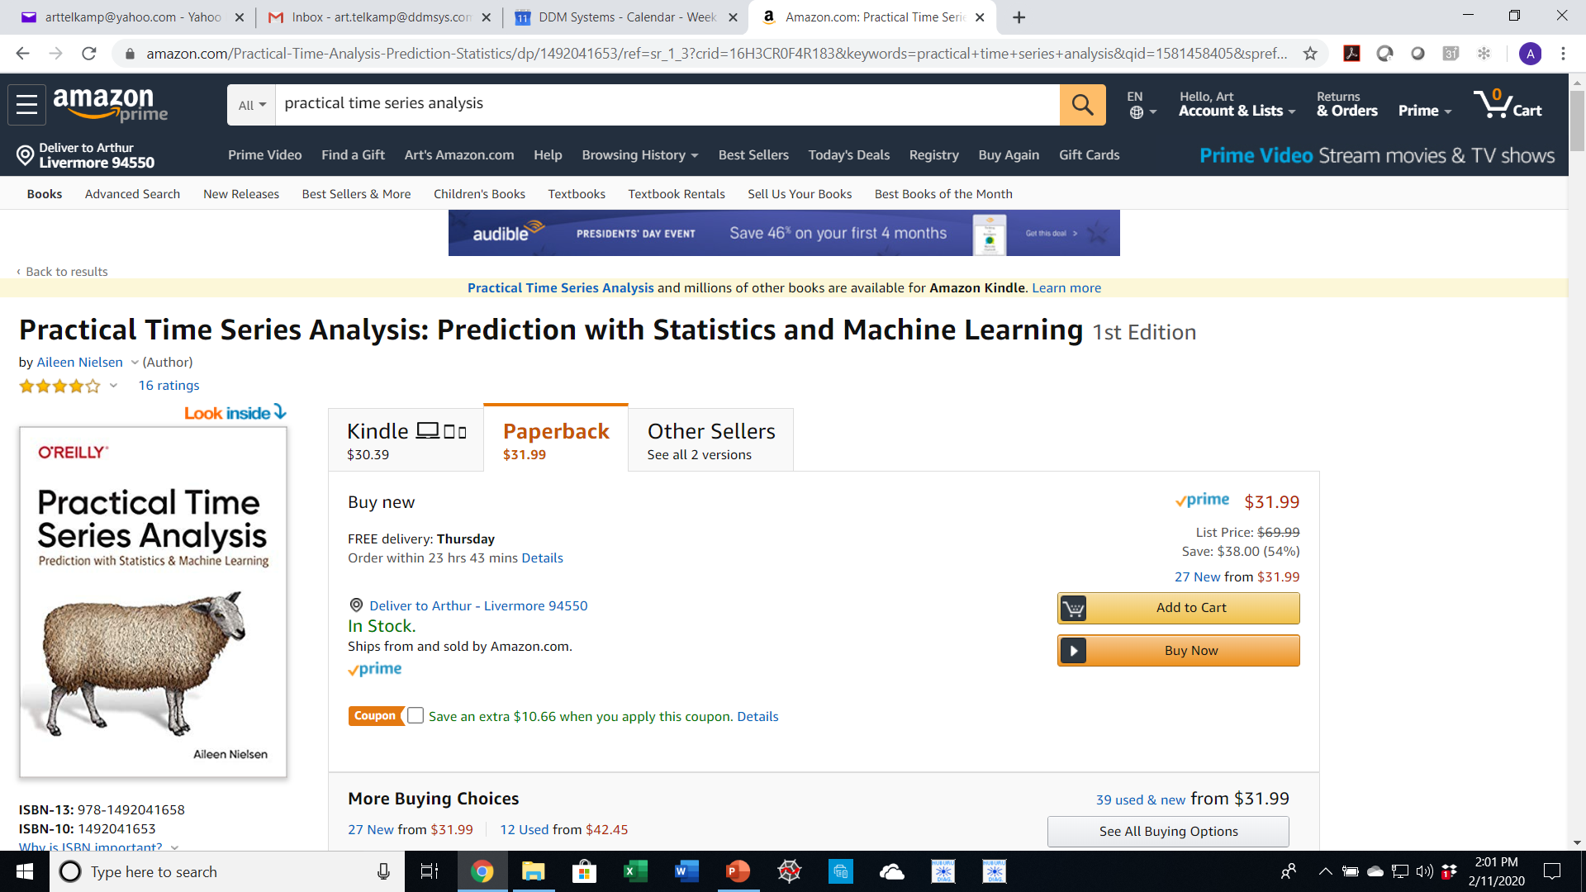
Other supplemental books (but not required)

Slide 9
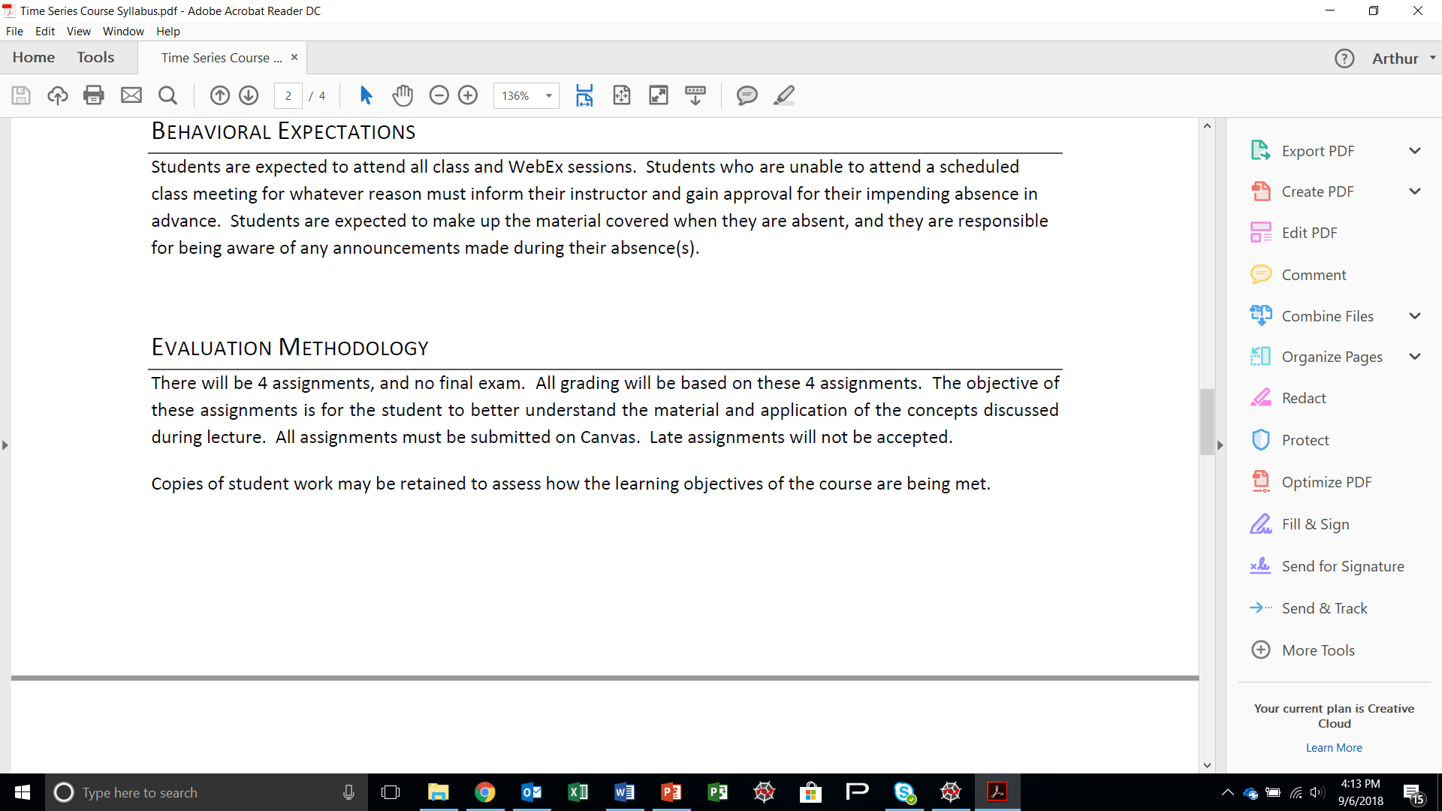
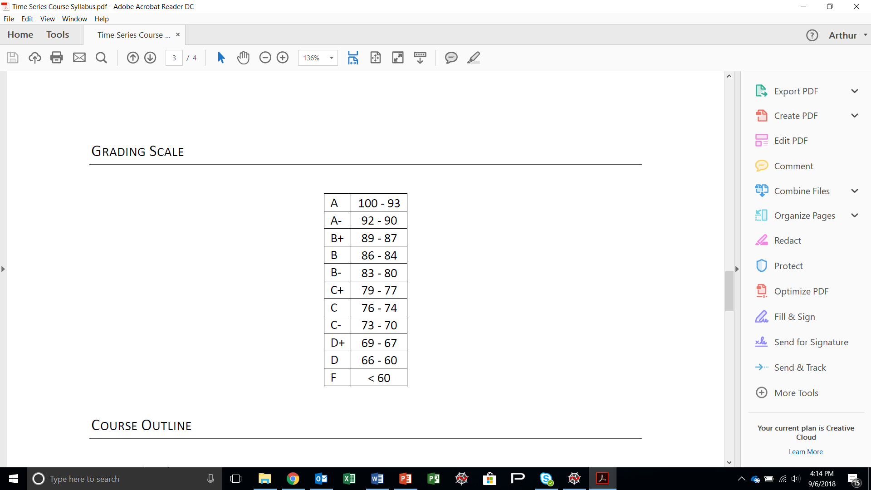
Assignments & Grading
Grading Scale:

Slide 10
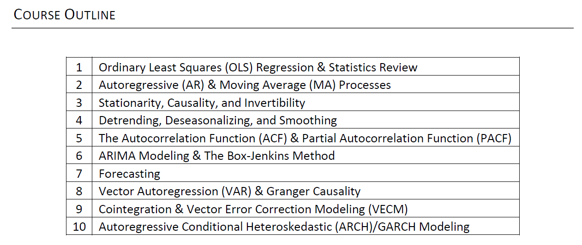
Syllabus

Slide 11
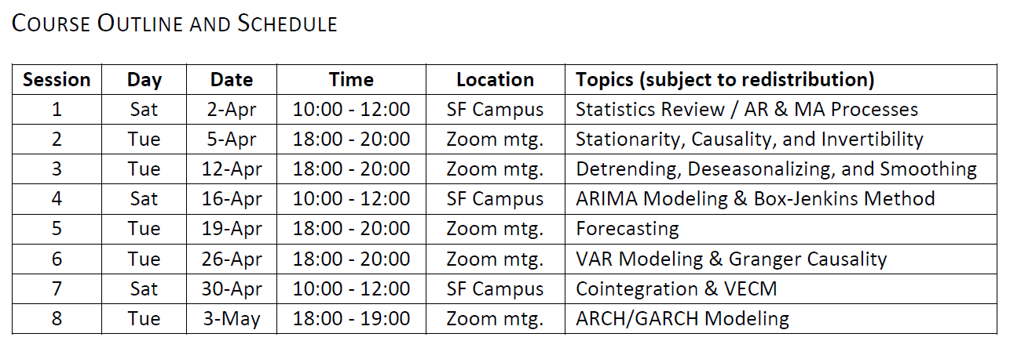
Syllabus

Slide 12
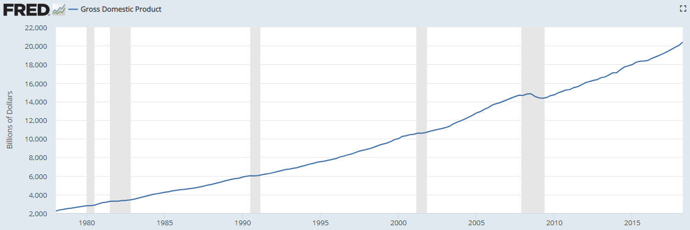
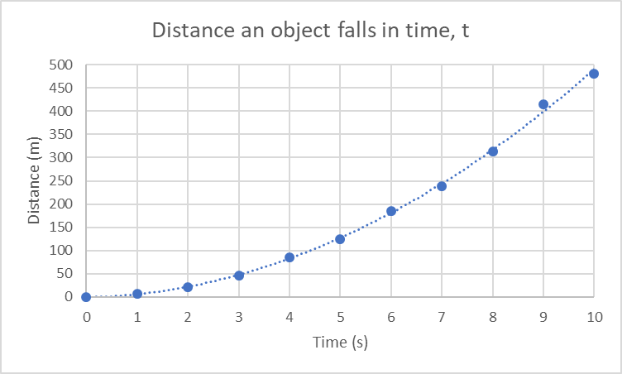
What is a Time Series?
What it is
A series of data points (observations) indexed in time order
Taken at successive equally spaced points in time
In general, successive points have some dependence on previous points, e.g.:
Stock value
Weather patterns
What it is not
Data sets where time is the independent variable
Predictable and repeatable processes that are functions of time (where data, as a function of time, can be taken in any order).
GDP 1978-2018

Slide 13
Why Time Series Analysis?
Extract meaningful statistics and other characteristics from the time series data
Forecast future values based on previously observed values
Econometrics
Weather forecasting
Earthquake prediction
Astronomy
Pattern recognition
Neuroscience
Signal processing
Control & communications engineering

Slide 14
How time series fits with machine learning
Different from most supervised machine learning algorithms.
Most supervised machine learning algorithms are primarily designed for fitting new data within a known group (interpolation).
Linear regression
Logistic regression
Support Vector Machines
Decision Trees
Time series data provides a basis for forecasting (extrapolation) only.

Slide 15
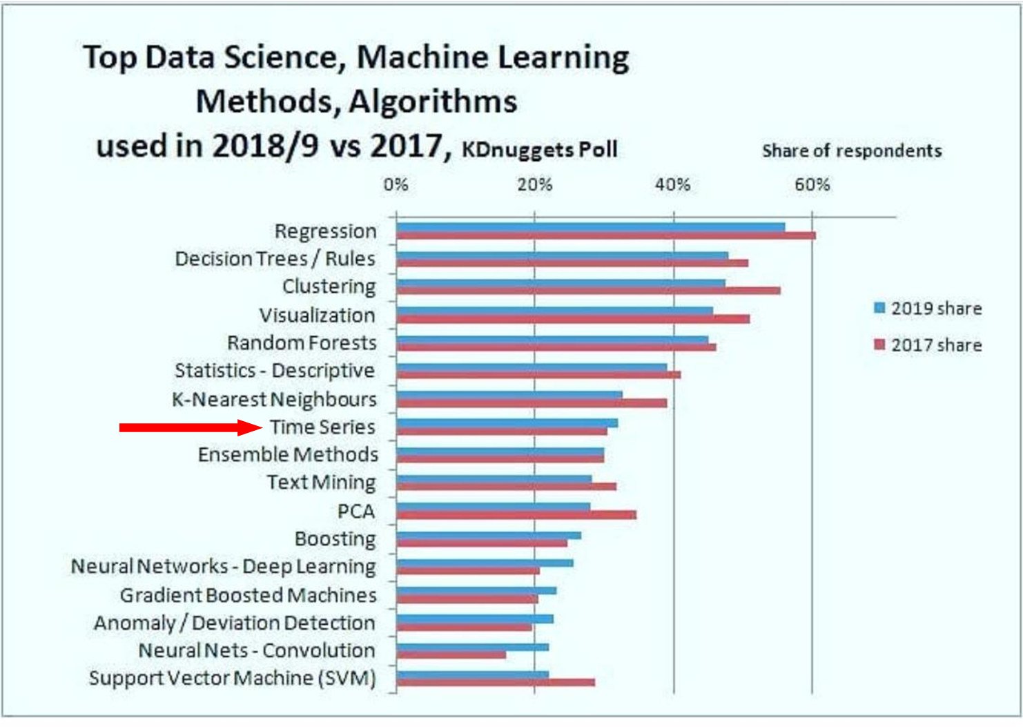
Top Machine Learning Methods 2019 vs. 2017
Increase in usage from 2017 to 2019, based on respondents

Slide 16
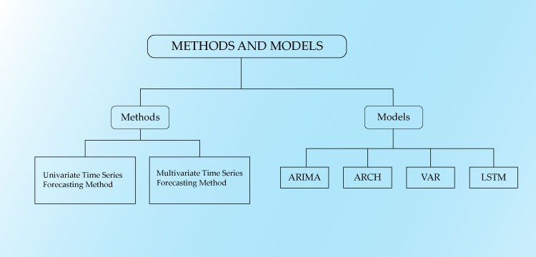
Time Series Analysis Methods and Models
Auto-
Regressive
Integrated
Moving
Average
Auto-
Regressive
Conditional
Heteroskedastic
Vector
Auto-
Regression
Long
Short-
Term
Memory
(class of Recurrent Neural Network)
https://www.analyticssteps.com/blogs/introduction-time-series-analysis-time-series-forecasting-machine-learning-methods-models

Slide 17
Python
Go to http://jupyter.org/install
Download Anaconda Distribution
Download Python 3.6 or greater
Install Anaconda

Slide 18
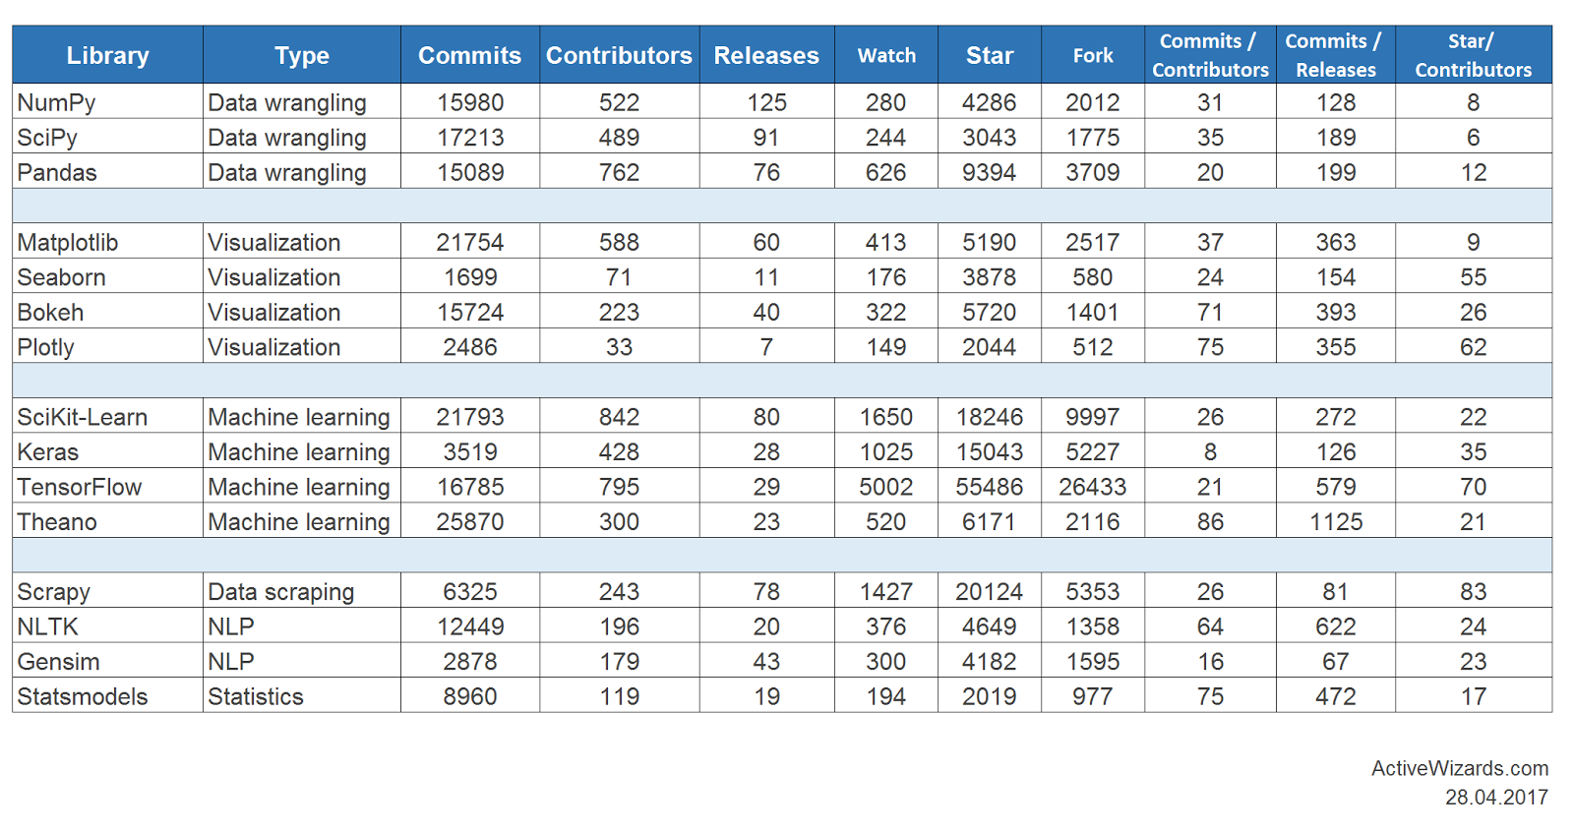
Libraries
Latest as of 10 Sep 2019:
scipy: 1.3.0
numpy: 1.16.4
matplotlib: 3.1.1
pandas: 0.24.2
statsmodels: 0.10.0
sklearn: 0.19.1

Slide 19
Ordinary Least Squares (OLS) Regression & Statistics Review

Slide 20
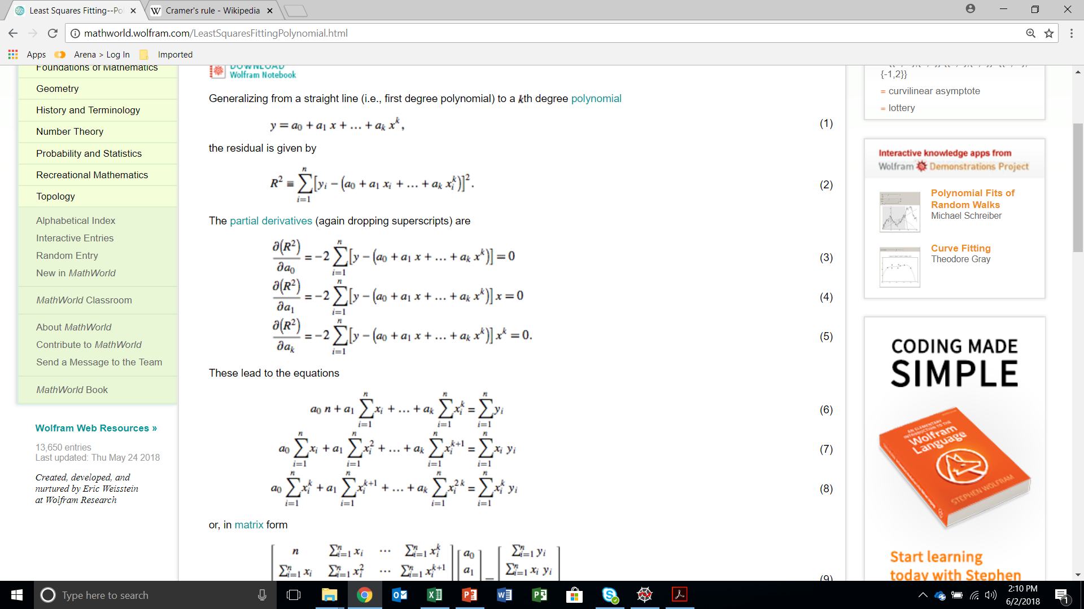
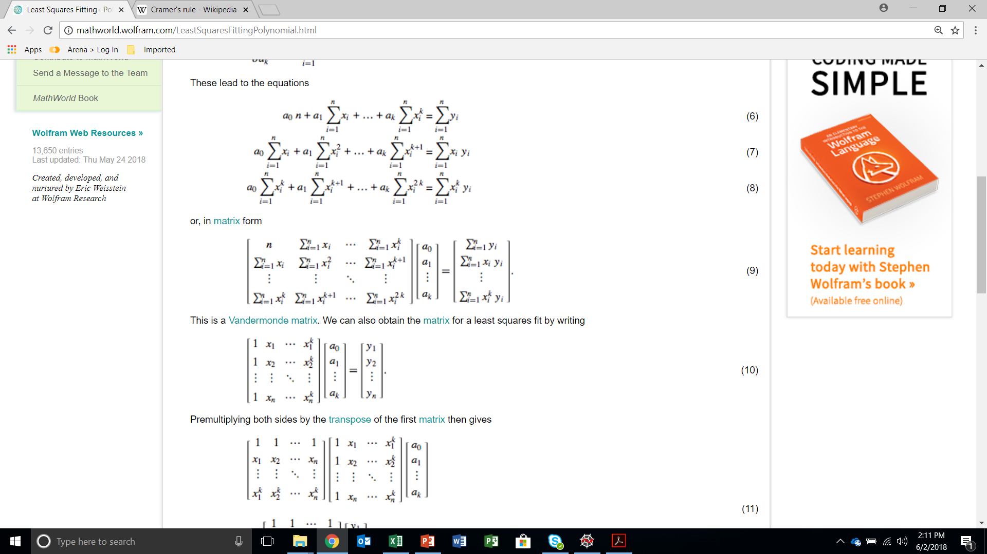
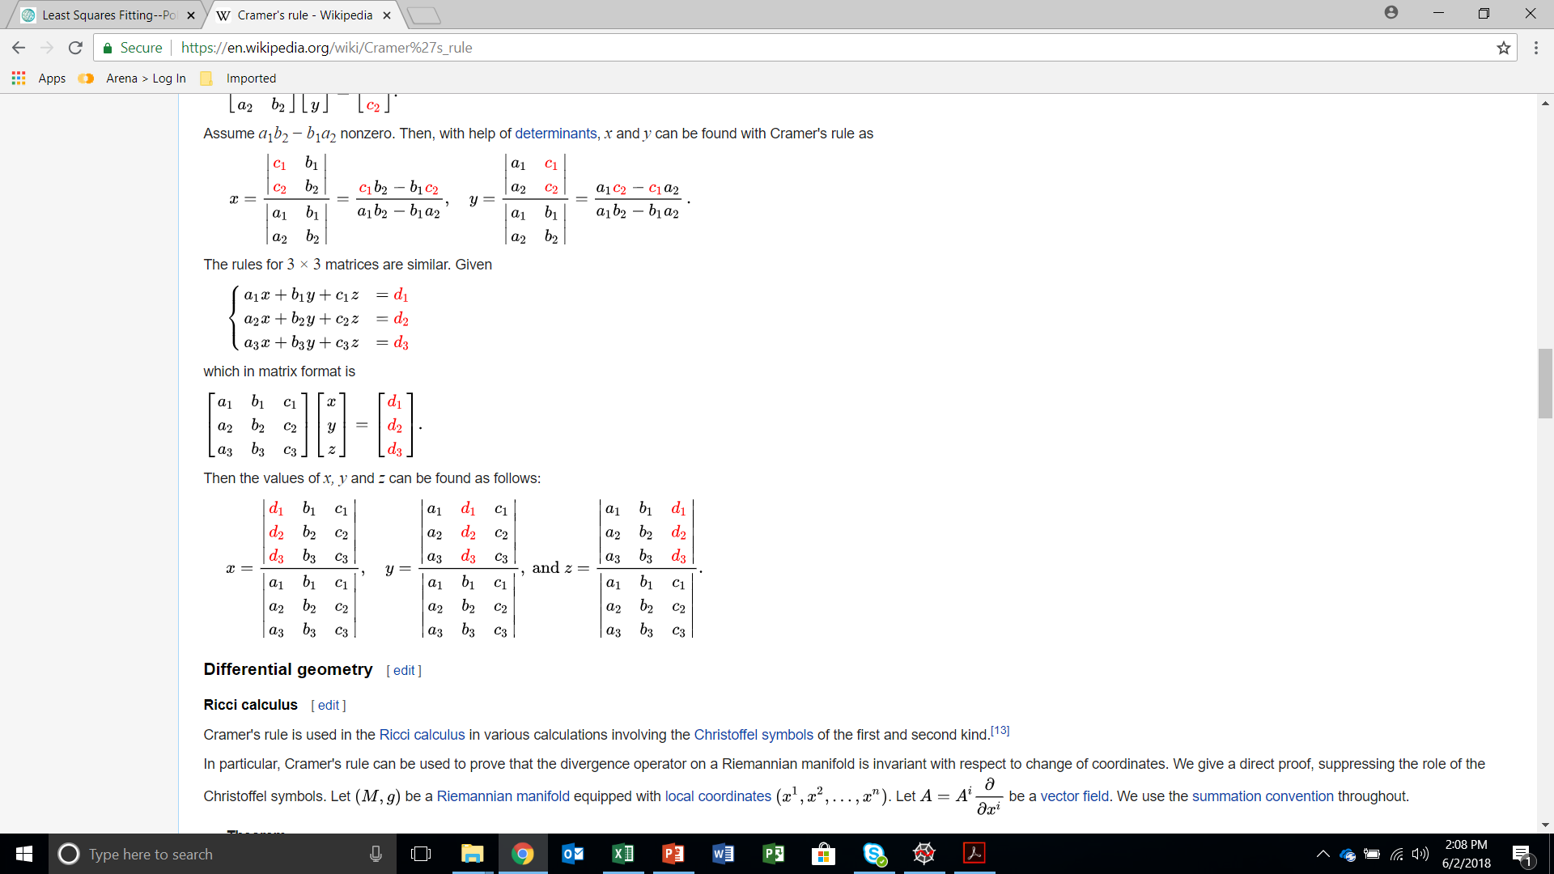
OLS Regression
Find a₀, a₁, …, a_{k} by implementing Cramer’s rule:

Slide 21
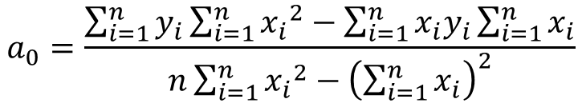
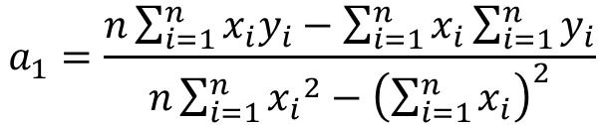
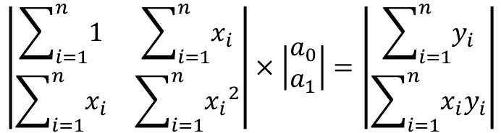
1st order OLS regression example
Coefficient Matrix
Variable Vector
Constant Vector
$$\left|\begin{matrix}\sum_{i=1}^{n}{1} & \sum_{i=1}^{n}{x_{i}} \\ \sum_{i=1}^{n}{x_{i}} & \sum_{i=1}^{n}{{x_{i}}^{2}}\end{matrix}\right|×\left|\begin{matrix}a_{0} \\ a_{1}\end{matrix}\right|=\left|\begin{matrix}\sum_{i=1}^{n}{y_{i}} \\ \sum_{i=1}^{n}{x_{i}y_{i}}\end{matrix}\right|$$
$$a_{0}=\frac{\sum_{i=1}^{n}{y_{i}}\sum_{i=1}^{n}{{x_{i}}^{2}−\sum_{i=1}^{n}{x_{i}y_{i}}\sum_{i=1}^{n}{x_{i}}}}{n\sum_{i=1}^{n}{{x_{i}}^{2}}−{\left(\sum_{i=1}^{n}{x_{i}}\right)}^{2}}$$
$$a_{1}=\frac{n\sum_{i=1}^{n}{x_{i}y_{i}−\sum_{i=1}^{n}{x_{i}}\sum_{i=1}^{n}{y_{i}}}}{n\sum_{i=1}^{n}{{x_{i}}^{2}}−{\left(\sum_{i=1}^{n}{x_{i}}\right)}^{2}}$$

Slide 22
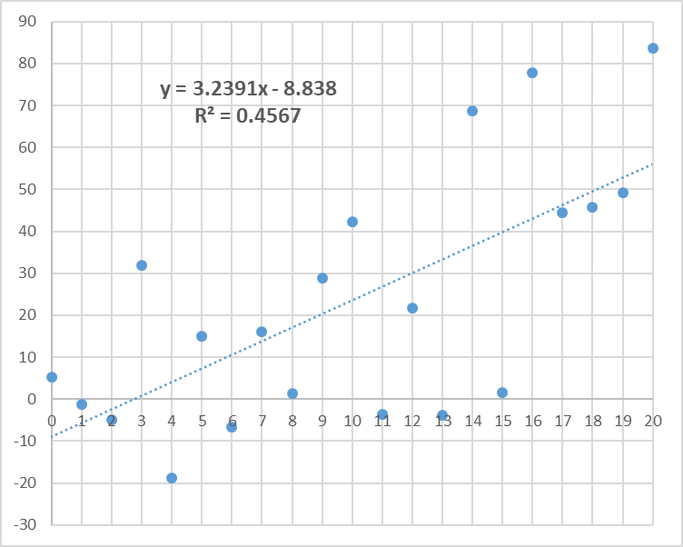
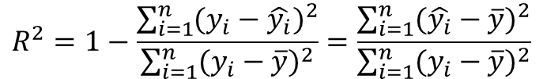
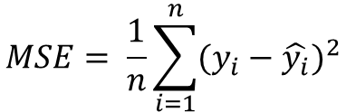
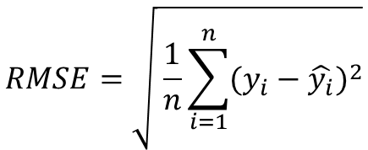
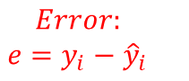
OLS Regression
Resulting errors:
The sum of the squares of the errors are minimized
The average of the errors = 0
$$Error:$$
$$e=y_{i}−{\hat{y}}_{i}$$
$$MSE= \frac{1}{n}\sum_{i=1}^{n}{(y_{i}−\hat{y_{i}})^{2}}$$
$$RMSE=\sqrt{ \frac{1}{n}\sum_{i=1}^{n}{(y_{i}−\hat{y_{i}})^{2}}}$$
Coefficient of Determination:
$$R^{2}=1−\frac{\sum_{i=1}^{n}{(y_{i}−\hat{y_{i}})^{2}}}{\sum_{i=1}^{n}{(y_{i}−\overline{y})^{2}}}=\frac{\sum_{i=1}^{n}{(\hat{y_{i}}−\overline{y})^{2}}}{\sum_{i=1}^{n}{(y_{i}−\overline{y})^{2}}}$$

Slide 23
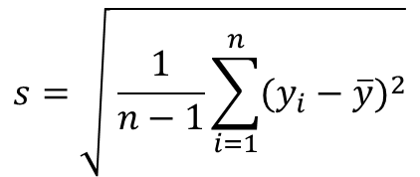
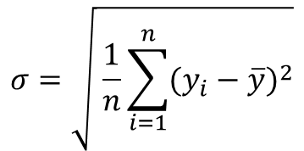
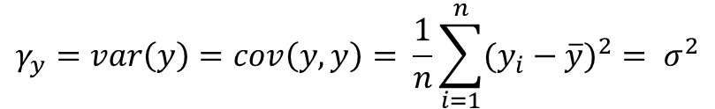
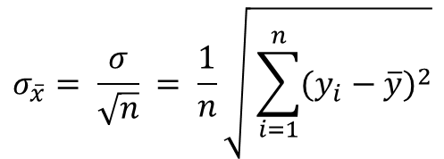
Statistics review
$$σ=\sqrt{ \frac{1}{n}\sum_{i=1}^{n}{(y_{i}−\overline{y})^{2}}}$$
Standard Deviation
$$s=\sqrt{ \frac{1}{n−1}\sum_{i=1}^{n}{(y_{i}−\overline{y})^{2}}}$$
Sample Standard Deviation
$$σ_{\overline{x}}= \frac{σ}{\sqrt{n}} = \frac{1}{n}\sqrt{ \sum_{i=1}^{n}{(y_{i}−\overline{y})^{2}}}$$
Standard Error
$$γ_{y}=var\left(y\right)=cov\left(y,y\right)= \frac{1}{n}\sum_{i=1}^{n}{(y_{i}−\overline{y})^{2}= σ^{2}}$$
Variance

Slide 24
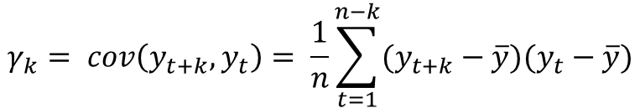
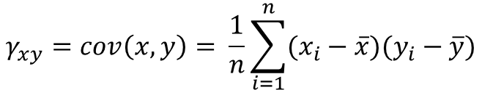
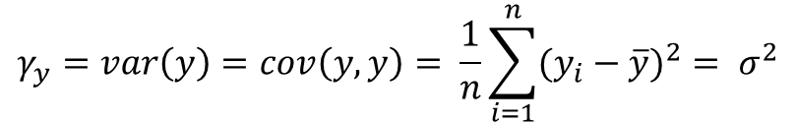
Statistics review
$$γ_{y}=var\left(y\right)=cov\left(y,y\right)= \frac{1}{n}\sum_{i=1}^{n}{(y_{i}−\overline{y})^{2}= σ^{2}}$$
Variance
$$γ_{xy}=cov\left(x,y\right)= \frac{1}{n}\sum_{i=1}^{n}{(x_{i}−\overline{x})(y_{i}−\overline{y})}$$
Covariance
$$γ_{k}= cov\left(y_{t+k},y_{t}\right)= \frac{1}{n}\sum_{t=1}^{n−k}{(y_{t+k}−\overline{y})(y_{t}−\overline{y})}$$
Autocovariance
k = number of lags

Slide 25
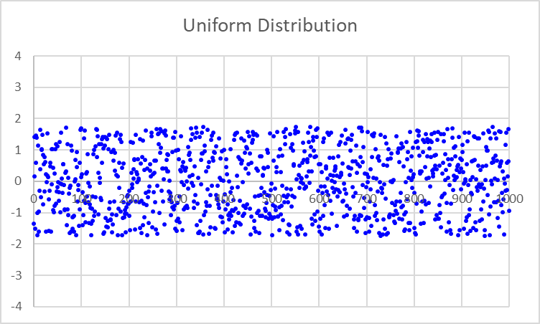
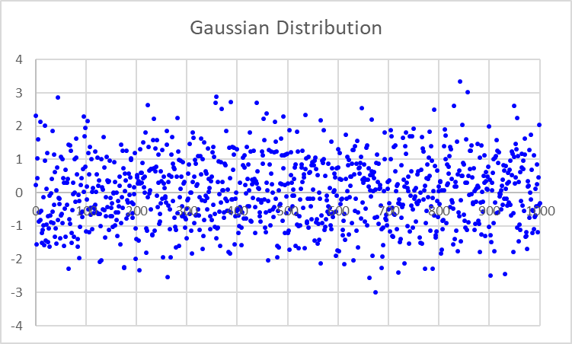
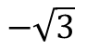
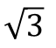
White Noise
Equal weighting on all frequencies (uniform PSD)
Points are independent and identically distributed (iid)
Uncorrelated and completely random
Identically distributed about the mean (mean = 0)
Must have a mean of 0 and a finite variance = σ²
Can have different distributions, but a Gaussian, or Normal, distribution is most common
Denoted as e_{t} ~ iid N(0,σ_{e}²)
Both of these distributions have σ_{e} = 1
$$\sqrt{3}$$
$$−\sqrt{3}$$

Slide 26
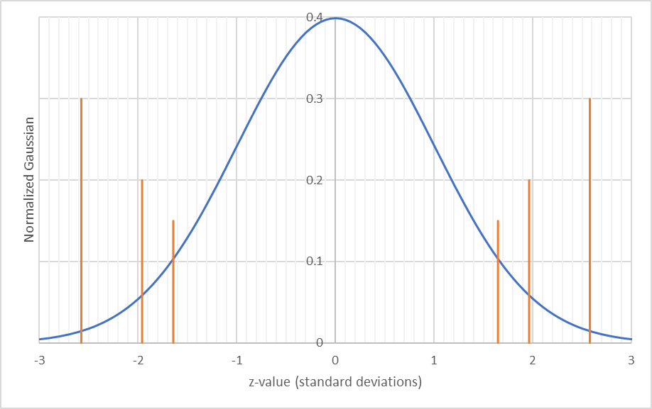
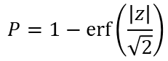
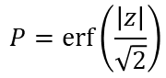
The Gaussian Distribution
Model Fitting
Hypothesis Testing
p-value = Probability of falsely rejecting the null hypothesis
(probability that the null hypothesis prevails)
= Total area under curve from both tails
Confidence interval
99%
Reject null hypothesis
If p < 0.05 (high significance)
Accept null hypothesis if p > 0.05
95%
90%
1.645
1.960
2.576
1.645
1.960
2.576
$$P=erf⁡\left(\frac{\left|z\right|}{\sqrt{2}}\right)$$
$$P=1−erf⁡\left(\frac{\left|z\right|}{\sqrt{2}}\right)$$

